Slide 1
State Diagrams
Notes:
A state diagram shows the behavior of classes in response to external stimuli. Specifically a state diagram describes the behavior of a single object in response to a series of events in a system. Sometimes it's also known as state machine diagram.

Slide 2
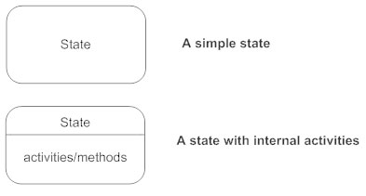
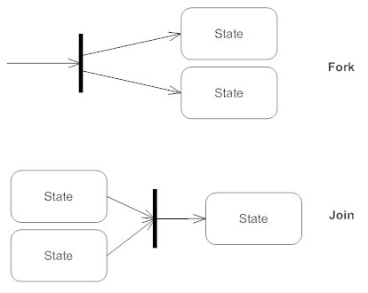


Parts of a State diagram
Notes:
Not every part shown will be in a state diagram nor is this every kind of symbol but just a small example

Slide 3
EXAMPLES
State Diagrams

Slide 4
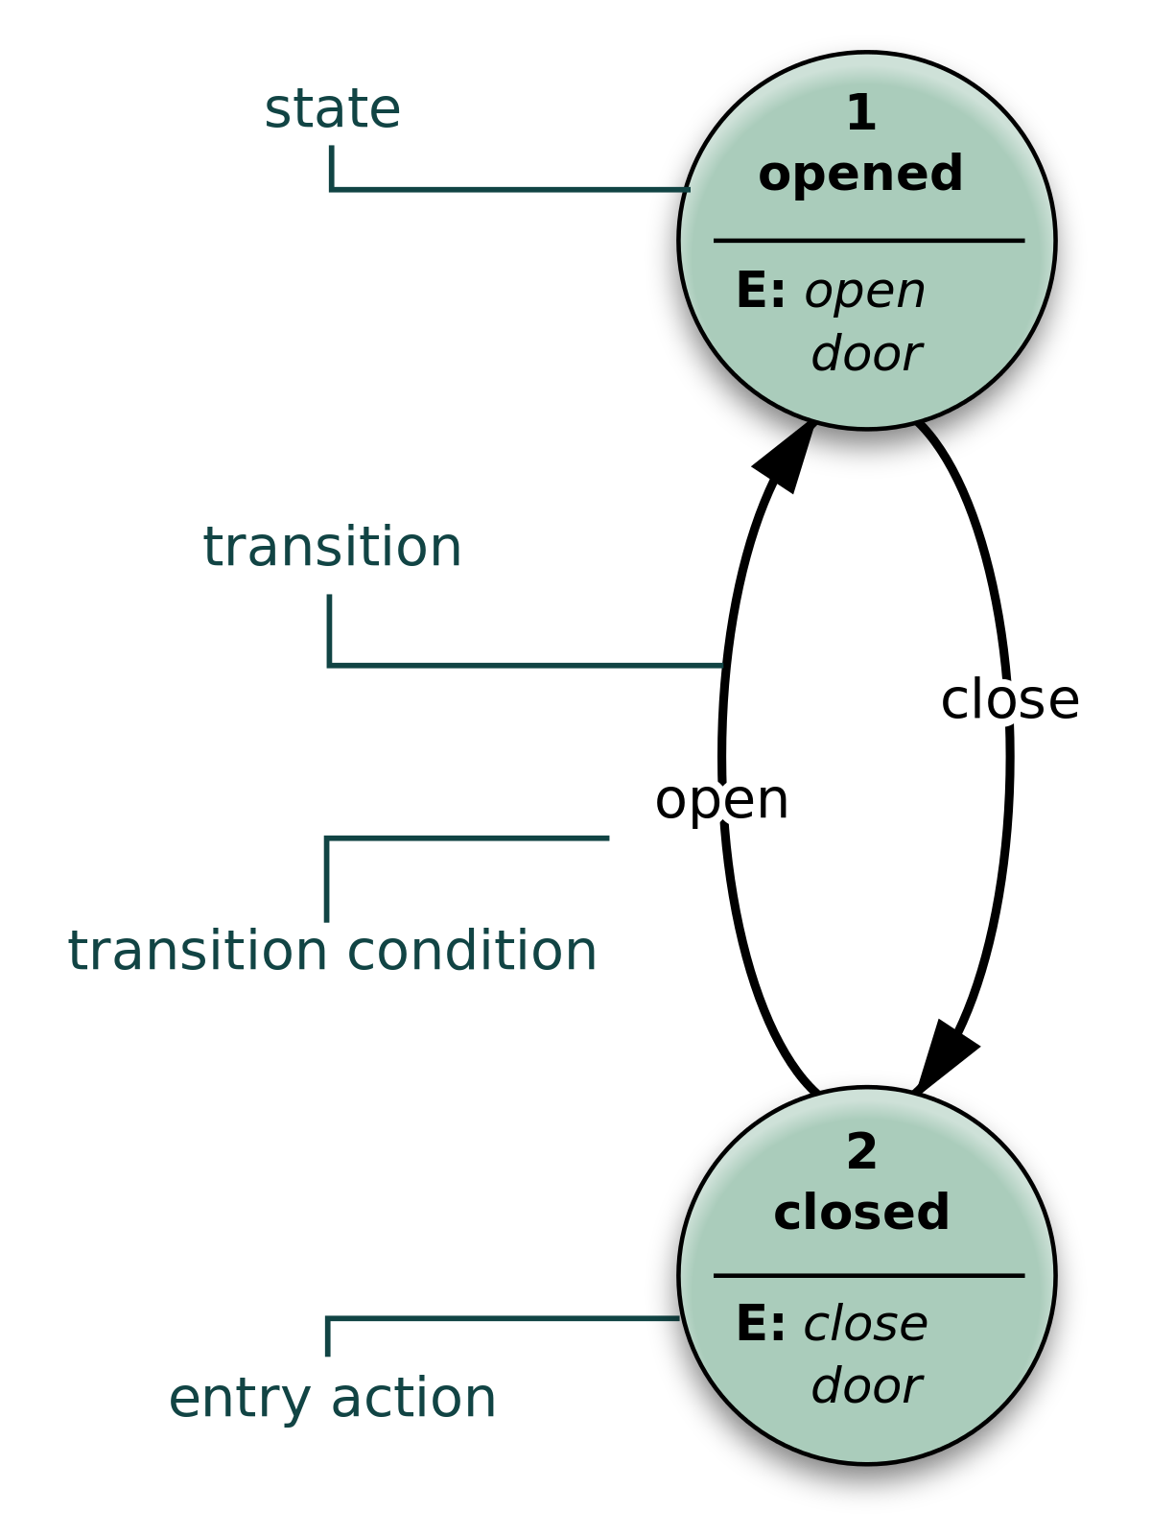
The door
Notes:
In this example we have a state diagram for a door. If you google state diagram it will be one of the first diagrams you find. In it the door is open or closed and nothing in-between.

Slide 5
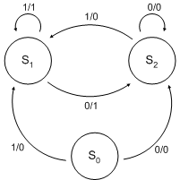
Binary
Notes:
In this diagram we see how the diagram can become more complex. In coding we can see where a If than statement would come into play with this diagram.

Slide 6
The State VS. Flow

Slide 7
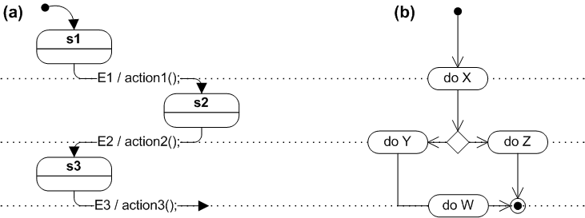
Notes:
In example A we have a state diagram and in B flow chat. We can see how they look alike any why they can be confused. The state diagram has 3 states and 3 actions in response to events. Where as the flowchart goes from one transition to another when one is complete. A flowchart illustrates processes that are executed in the system that change the state of objects. A state diagram shows the actual changes in state, not the processes or commands that created those changes.

